Slide 1

Project 3: Neural Networks IE 6910 Python ML
Mohammed Abdul Najeeb Farooqui
Sarvesh

Slide 2
Required Dataset: Image Classification Cats vs Dogs

Slide 3
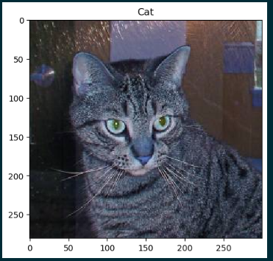
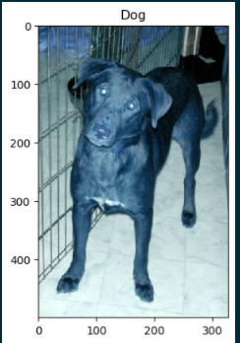

Look at the pictures in the datset
What we are looking for:
Samples from cat set and dog set
Count of how many images we have.

Slide 4
Creating test, train data set

Slide 5
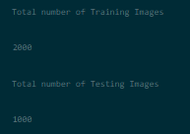
Creating testing and training data set.
We do a 33 percent split

Slide 6
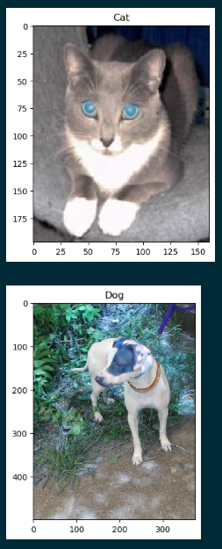
Training set
Training set has 2000 images of the 30000 images selected at random.
This is a sample of the pictures stored in the training set

Slide 7
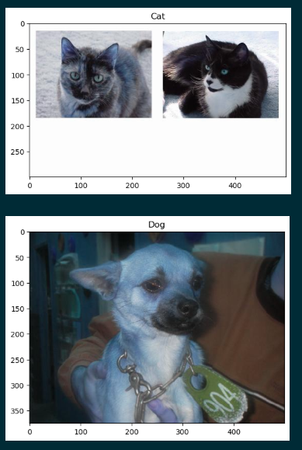
Testing set
There are 1000 images stored in the testing set
This is a sample of the pictures stored in the testing set

Slide 8
Preprocessing the images

Slide 9

Preprocessing
The images are converted to grayscale and resized so as to be handled appropriately by the model.
Color do not provide high levels of accuracy with CNN and that is why we choose to convert the images into grayscale images.
A sample of the images after preprocessing has been displayed.

Slide 10
Creating the network

Slide 11
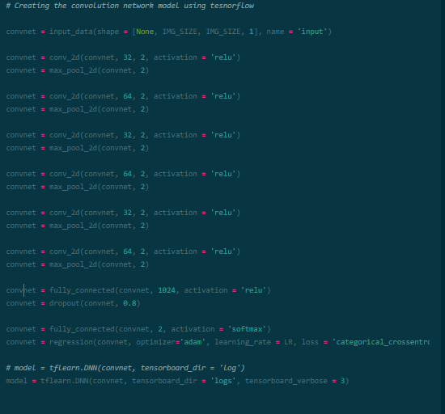
Network
For the purpose of this classification model we create a convolutional neural network to process the images
We create a CNN with 7 convnet layers
Each connected 6 maxpool_2d layers
In the end we have two fully connected layers to process the output from the CNN layers and give us an output of whether it’s a dog or a cat.
We use relu activation for out CNN models and softmax for the fully connected layer.

Slide 12
Training and analyzing results

Slide 13
Training
For training the model we wanted the model to not produce results that make the model to overfit the data or underfit the data.
For this we choose to train the model for 30 epochs after testing various epoch times and various comparisons between training accuracy, validation accuracy, training loss and accuracy loss.

Slide 14

Analysis
Below are displayed the final training loss, training accuracy, validation loss and validation accuracy.
After trying several combinations we came to the result that due to lack of data we are not able to achieve higher accuracy values,, and we hope that with more data our model would improve in it’s classification job

Slide 15
Prediction Results

Slide 16
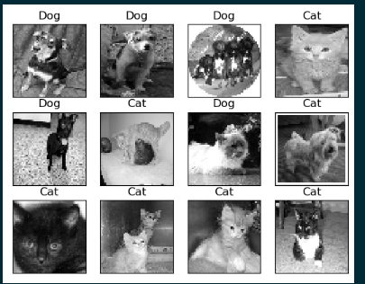
Predictions
These are the predictions we observe after predicting on the dataset that the model has never seen.

Slide 17
Self Selected Datasets: Image Classification Mnist Dataset

Slide 18
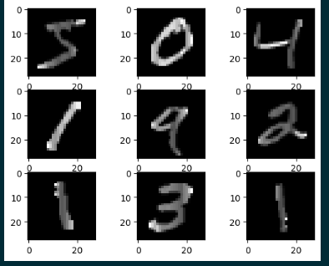

Data set Description
.Mnist dataset is a dataset stored in the TensorFlow library.
This is a dataset that contains 70000 pictures of handwritten number as a 28*28 bitmap images.

Slide 19
Creating test, train data set

Slide 20
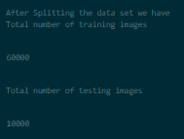
Creating testing and training data set.
We use 60000 images for training and 10000 images for testing

Slide 21
Preprocessing the images

Slide 22
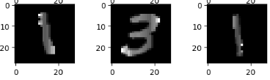
Preprocessing
The images present in the dataset are already present in a bitmap format which is what our model needs
We proceed further with the training and testing dataset which is in the form of an array of greymap images.

Slide 23
Creating the network

Slide 24
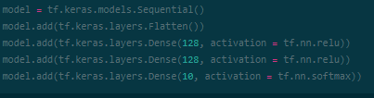
Network
For the purpose of this classification model we create a sequential model by using the models and layers present in the keras library.
We create 3 Dense Layers of the following specification.
Dense layer 1: 128, activation = relu
Dense layer 2: 128, activation = relu
Dense layer 3: 10, activation = softmax

Slide 25
Training and analyzing results

Slide 26
Training
For training the model we wanted the model to not produce results that make the model to overfit the data or underfit the data.
For this we choose to train the model for 3 epochs after testing various epoch times and various comparisons between training accuracy, validation accuracy, training loss and accuracy loss.

Slide 27
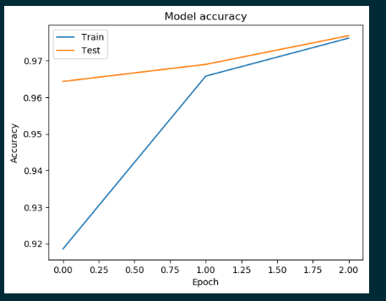
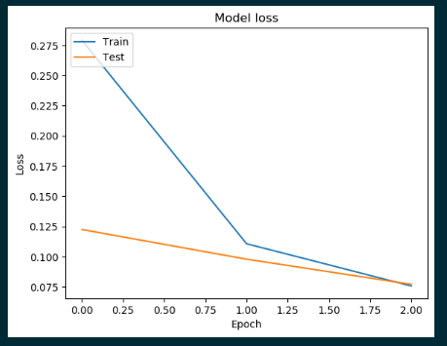
Analysis
Below are displayed the final training loss vs validation loss and Training accuracy vs validation accuracy graphs.
From the graphs we can observe that training loss~validation loss and training accuracy~validation accuracy, which is what we desire for a model that doesn’t underfit or over fit the data.

Slide 28
Prediction Results

Slide 29
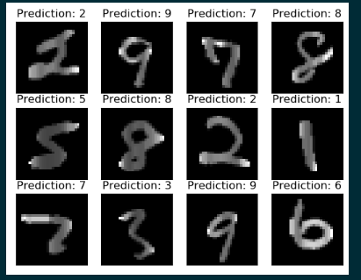
Predictions
These are the predictions we observe after predicting on the dataset that the model has never seen.

Slide 30
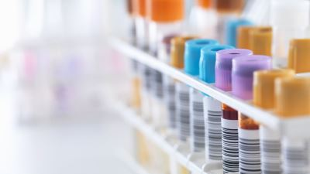
Diabetes Diagnostics
Sarvesh Sawant
Abdul Najeeb
IE 6910

Slide 31
Project Flow: Diabetes Diagnostics
Data Input
Descriptive analysis
Exploratory Data analysis
Splitting the data in train and test sets
Training the model and predicting target variable
Feature importance by applying random noise
Sensitivity analysis to get the best test-train split ratio
Generating 10 random instances of the features and predicting the target variable

Slide 32
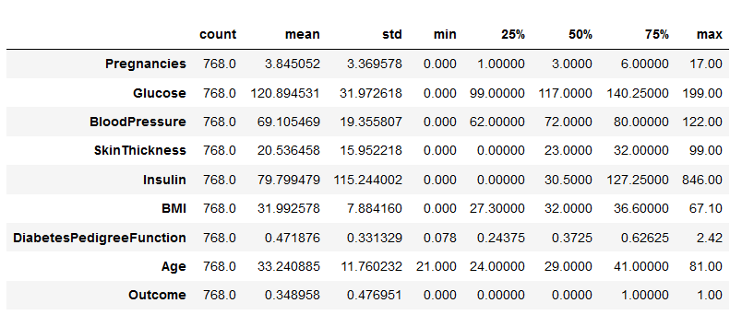
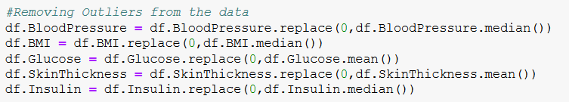
Descriptive Analysis
We can clearly see that certain features have a minimum value of 0.
Blood pressure (diastolic pressure) of 0 does not make any sense.
Similarly other features like glucose, skin thickness, BMI, insulin have minimum values as 0.
Maximum number of pregnancies recorded is 17. Even though it seems like an highly improbable value, such cases can exist in real life so no changes were made to the pregnancy data .
For the above mentioned columns we have replaced the minimum value either by the mean or the median value based on suitability.

Slide 33
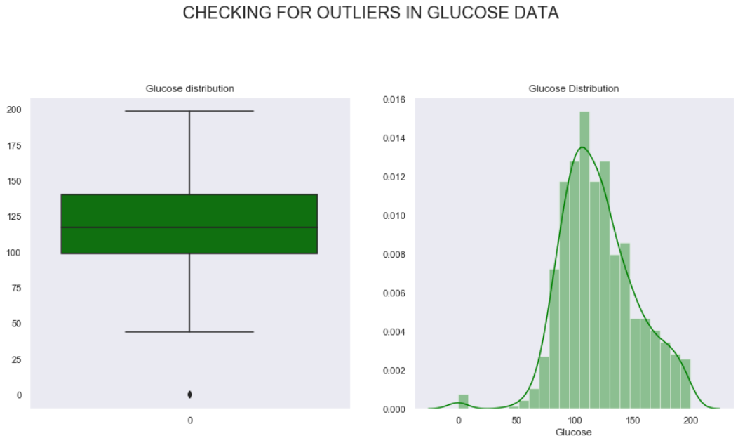
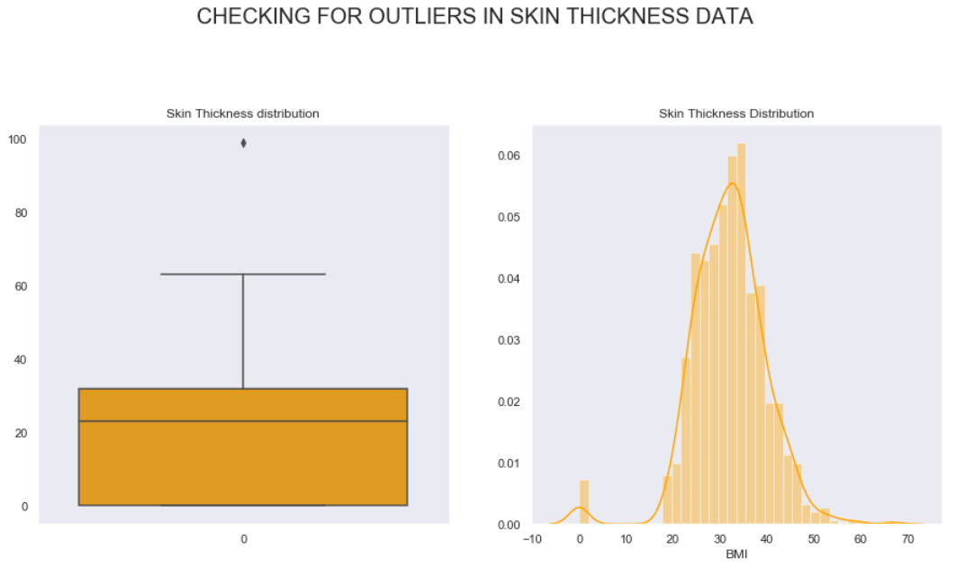
EDA: Finding Outliers through Data Visualization
As discussed earlier many of the features have outliers or corrupt data that can affect the diagnostic quality.
Data visualization is an affective technique to evaluate and interpret certain flaws in the dataset. In the glucose data it is evident from the box plot that there are a certain value of 0 in the dataset. Similarly by the combination of histogram and box plot we can gauge the percentage of data that is corrupted and thus can replace them with the mean or median value.

Slide 34
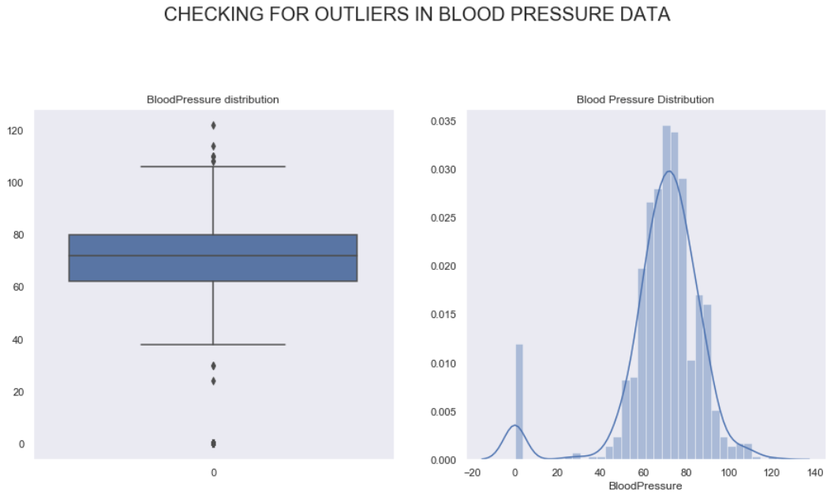
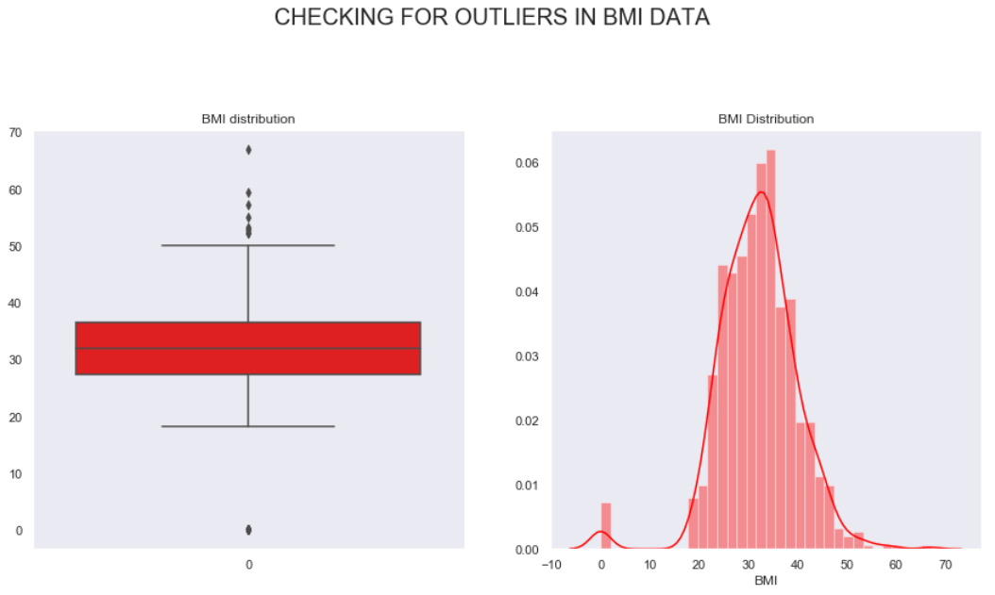
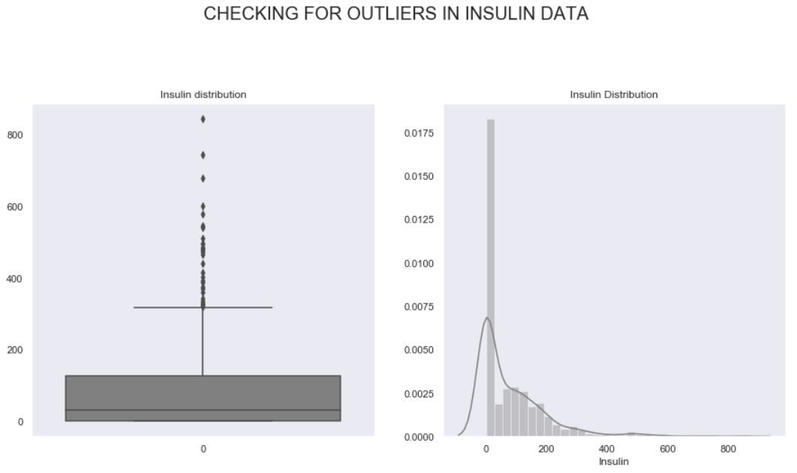
Both the Blood pressure and BMI columns have 0 as their lowest value which is not practically possible under normal circumstances so we have replaced them with median values.
The highest value for diastolic pressure in the dataset is 122 which can be considered as it is practically possible for a person to reach such alarming diastolic pressure values in certain situations.

Slide 35
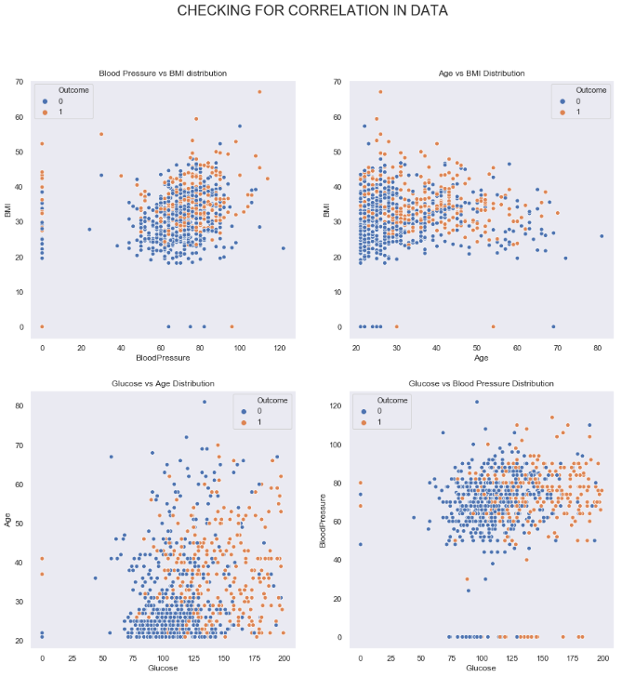
There is no correlation between the features that we have plotted here.
It is difficult to separate the clusters of diabetic and non diabetic patients.
This suggest that the features are independent of each other and individually have an effect on the outcome of the diagnostics.
When we are unable to identify clusters in the data it means that a single perceptron or the neuron won’t be sufficient enough to estimate the outcome of the diagnosis, because a single perceptron can only solve linearly separable problems and that isn’t the case in our Diabetes dataset.
This indicates that we have to use a multiple layer perceptron model to do the classification task here.
This model has multiple hidden layers of perceptron that enable the non linear classification process.

Slide 36
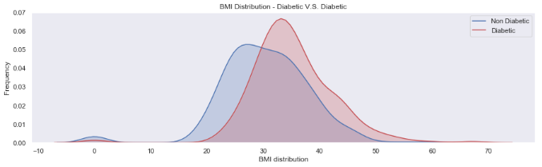
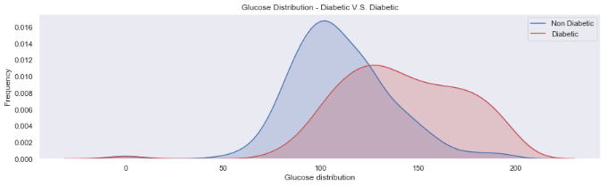
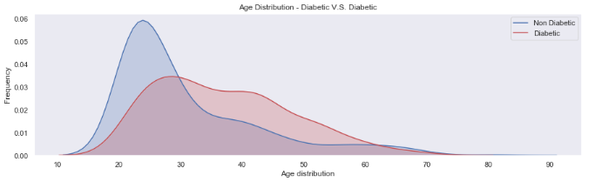
People having BMI more than 30 are at a higher risk of being diabetic.
People having glucose level of 120 or more at risk of being diabetic.
There is an unexpected spike in the number of diabetic people in the age range of 20-40

Slide 37
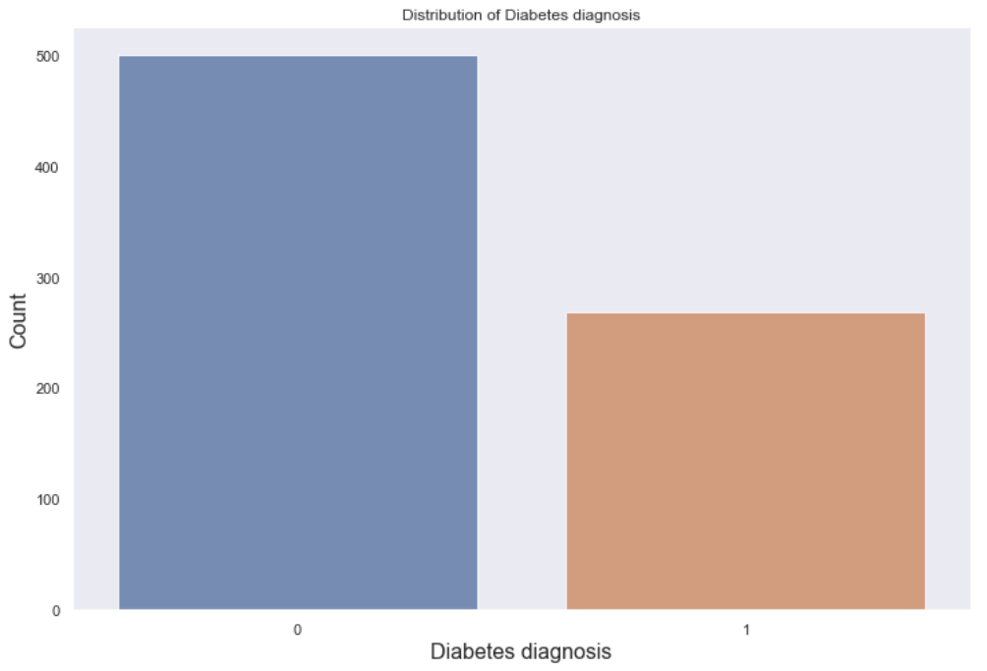
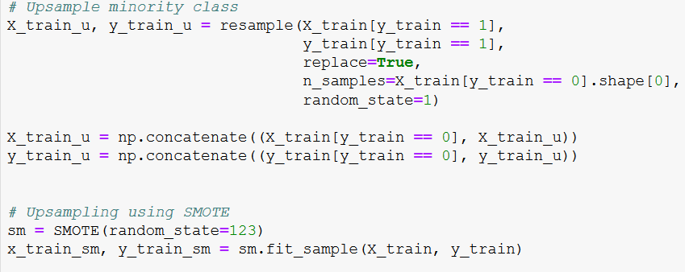
Checking for Class Imbalance
We can clearly see that the number of Diabetic patients are much lesser as compared to that of the non diabetic patients and that is the scenario in real life.
To eliminate the class imbalance we up sample the minority class to produce identical instances of positive cancer patients.
For the purpose of up sampling we use the smote sampling technique and the up sampling technique.
The new points are artificial instances generated based on the actual points closest to them.

Slide 38
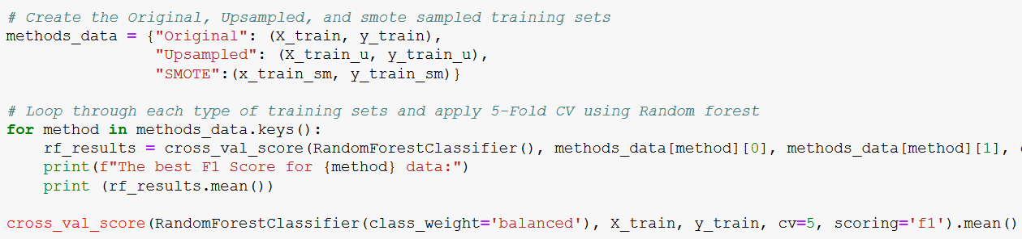
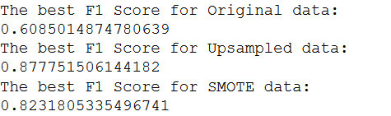
5 fold cross validation using Random forest algorithm to get the best sampling technique
Based on the F1 scores we can see that the up sampled data produced better results (mean cross validation F1 score) and thus we selected the up sampled data to train our model

Slide 39
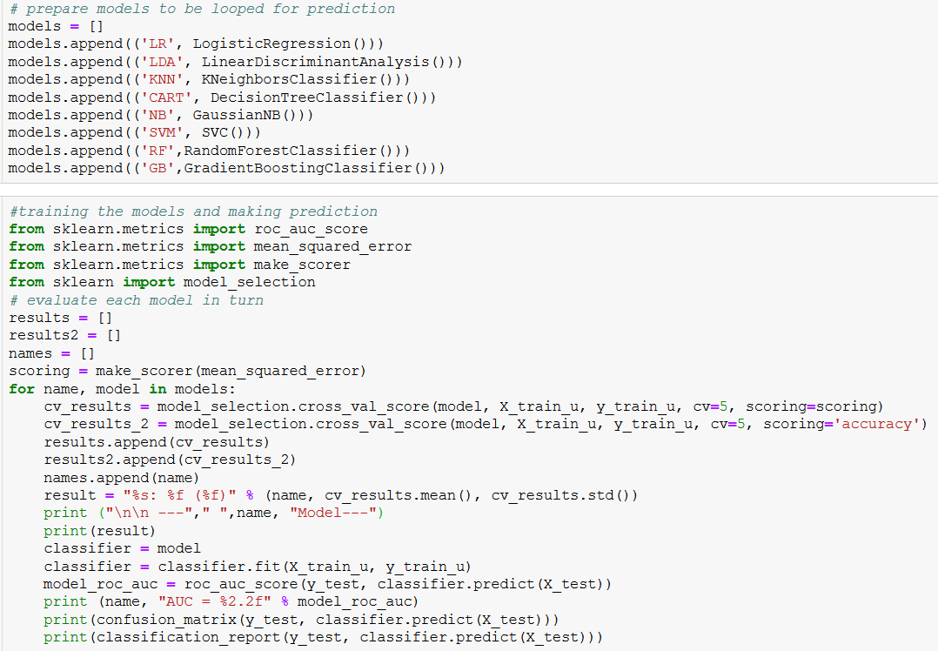
Training the models
The two results that we have calculated are
mean squared error and
accuracy
We compare the models based on these two scores.
Recall is also a critical aspect to be considered when we select the best model for prediction.

Slide 40
Precision vs Recall
In this case we give importance to Recall because
We want to limit the false negatives i.e. we do not want to lose out on an individual who has Diabetes
We can afford to have a few false positives because these false positive individuals aren’t at higher risk of having Diabetes and even if they are marked positive they would just be given extra attention and would need to get further test done to examine their condition and that is better than marking a Diabetic patient as non Diabetic.

Slide 41
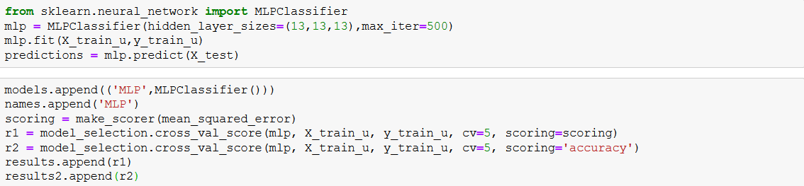
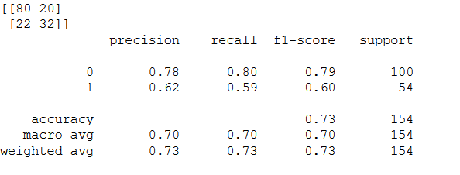
Multi Layer Perceptron Model
The accuracy score obtained by using the multi layer perceptron model is 73% but the recall is really low for the diabetic patients (59%) this makes the MLP model not the best for this classification.

Slide 42
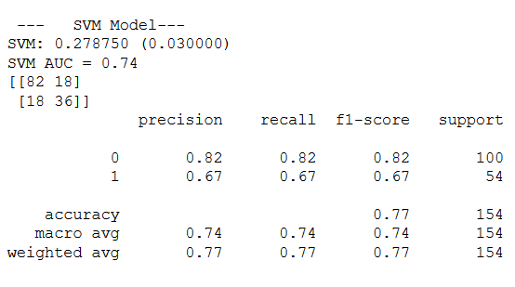
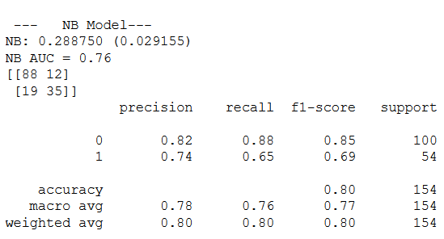

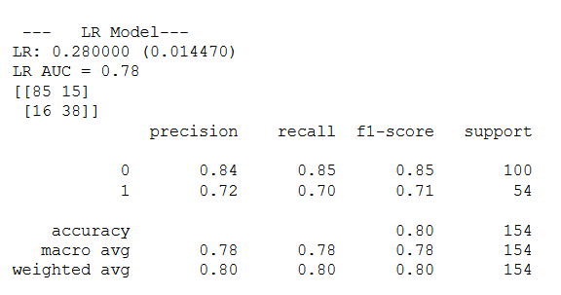
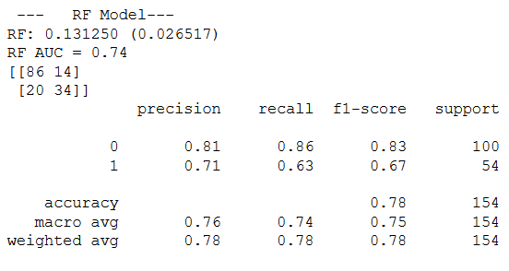
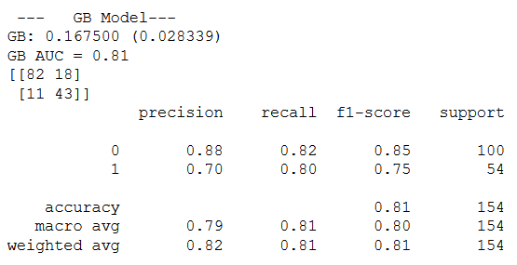
Results
Gradient Boosting is the best model because it produces the best accuracy (81%) and lowest mean squared error (0.16750)
In addition to this the Gradient Boosting model produces the highest recall for target (0.80)

Slide 43
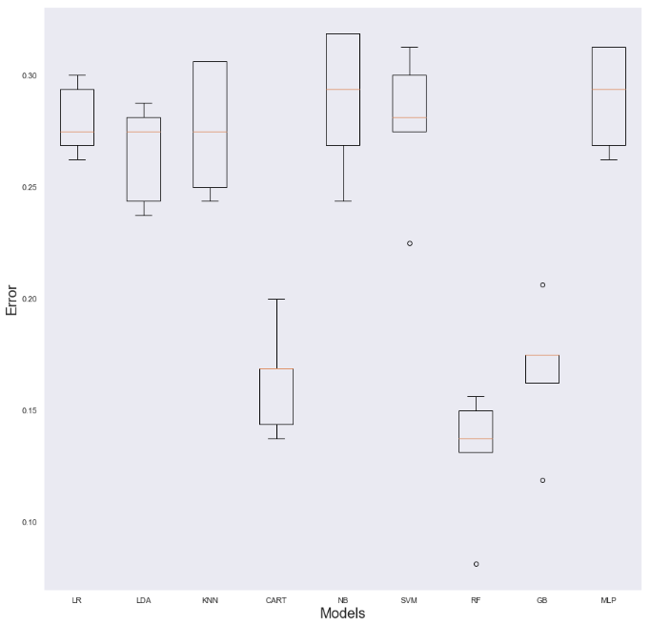
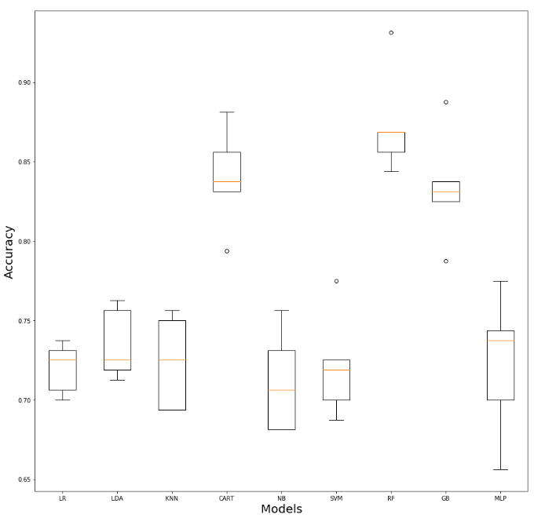
The Gradient Boosting model has the recorded one of the least cross validation mean squared error and the one the highest cross validation mean accuracy.

Slide 44
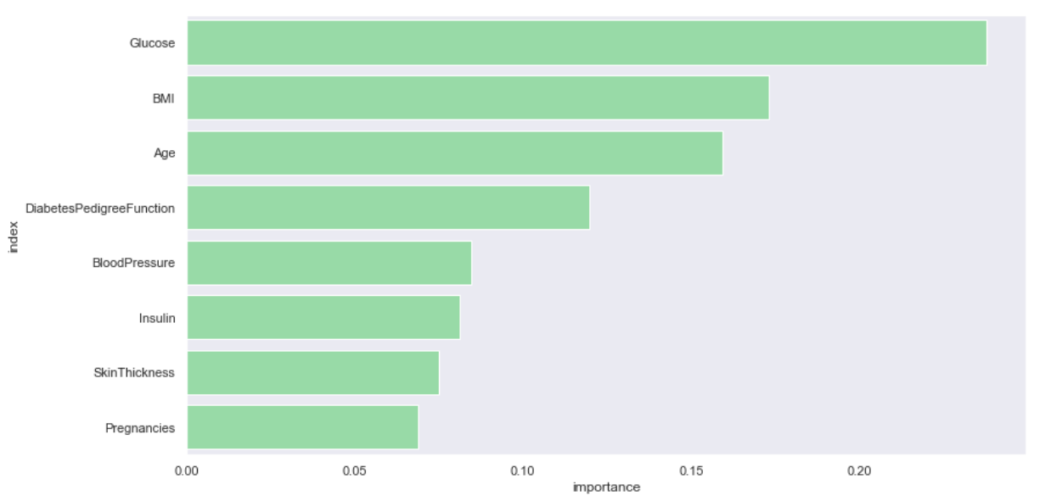
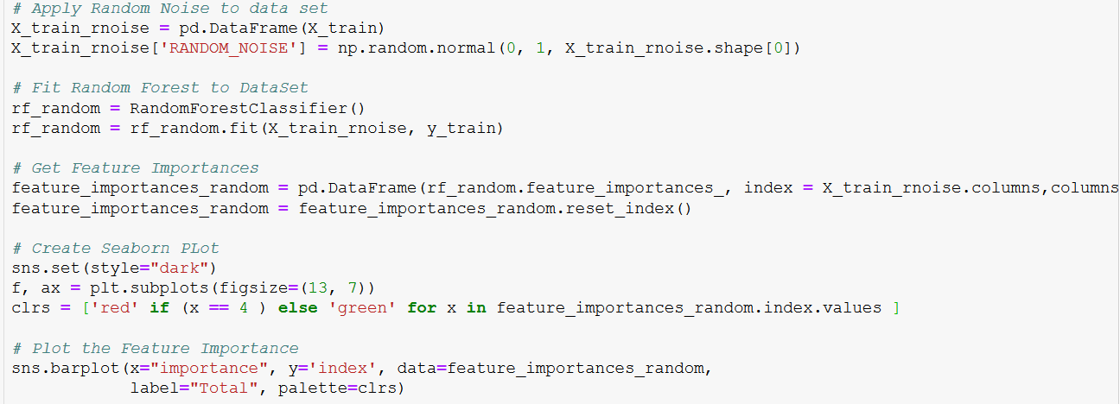
Feature Importance
In order to get the actual feature importance we have added random noise to our dataset and then we have again plotted the feature importance.
All the features above the random noise would be the actual important features that play a vital role in the diagnosis.

Slide 45
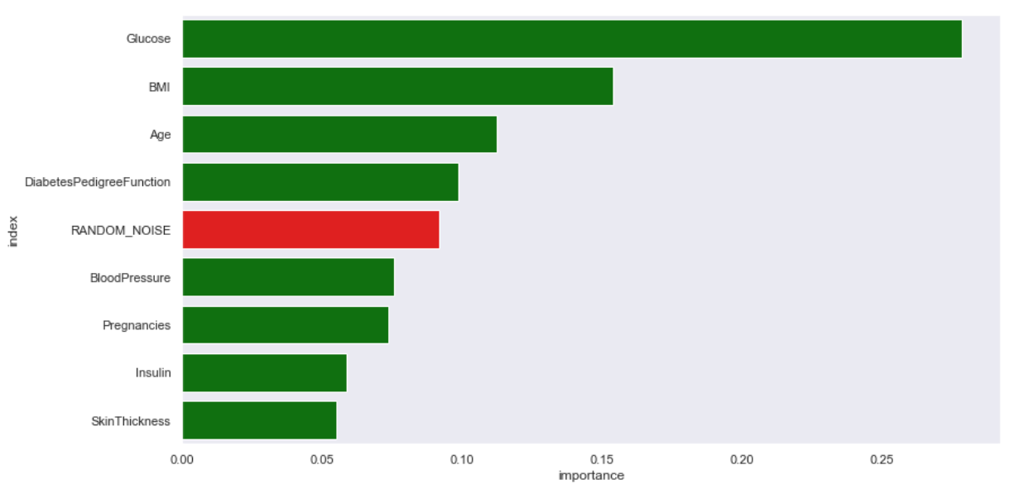
Feature Importance with Random Noise
All the features above the Random noise are the most critical features

Slide 46
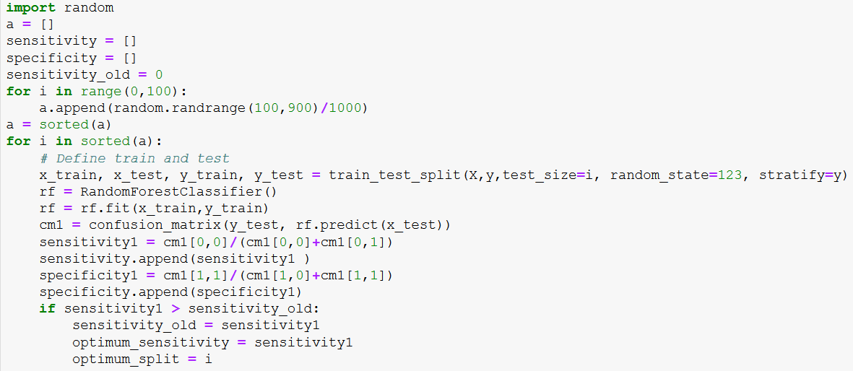
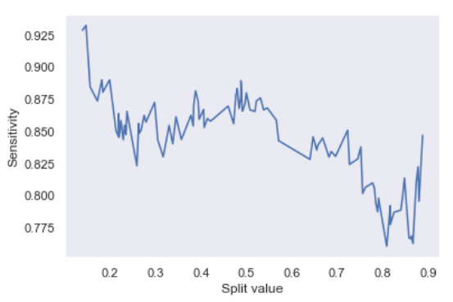
Sensitivity Analysis

Slide 47
Thank you!

